Slide 1
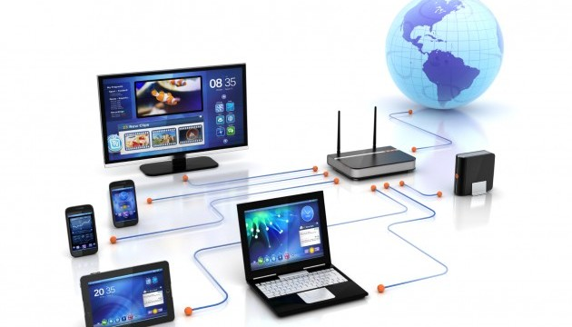
CSE101 Intro to CS and Programming
Basic Computer Networks
Lecture 13 (Week 7)
By Mr. Faheem Shaukat
faheem@iqraisb.edu.pk
www.tinyurl.com/IUICLectures

Slide 2

Network Topologies
Computer Fundamentals: Pradeep K. Sinha & Priti Sinha
Term network topology refers to the way in which the nodes of a network are linked together
Although number network topologies are possible, four major ones are:
Star Topology
Ring Topology
Mesh Topology
Bus Topology
Hybrid Network/Topology
Ref. Page 338

Slide 3
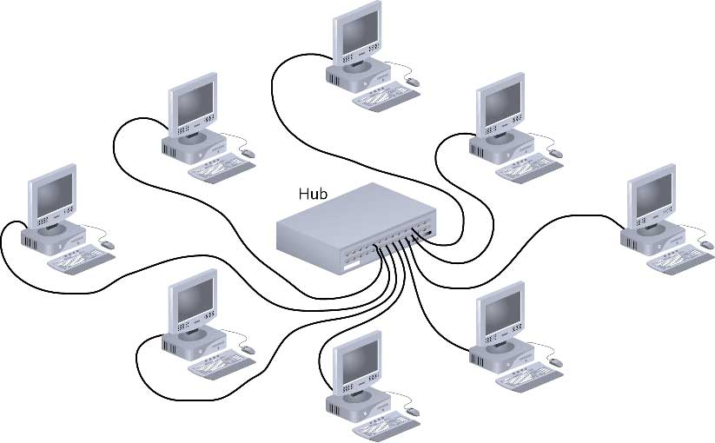
Star Topology/Network
Computer Fundamentals: Pradeep K. Sinha & Priti Sinha
A star topology is a topology for a Local Area Network (LAN) in which all nodes are individually connected to a central connection point, like a hub or a switch.
Ref. Page 339

Slide 4
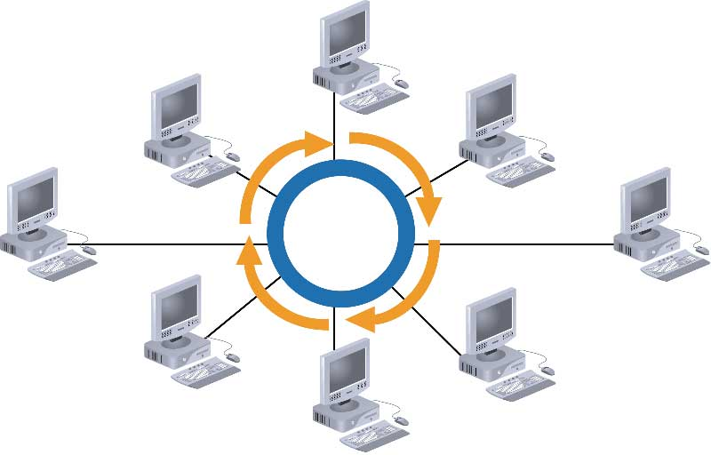
Ring Network Topology
Computer Fundamentals: Pradeep K. Sinha & Priti Sinha
A ring network is a network topology in which each node connects to exactly two other nodes, forming a single continuous pathway for signals through each node - a ring.
Ref. Page 339

Slide 5
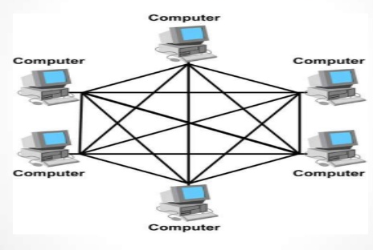
Mesh Network Topology
Computer Fundamentals: Pradeep K. Sinha & Priti Sinha
In a mesh network topology, each of the network node, computer and other devices, are interconnected with one another.
Ref. Page 340

Slide 6
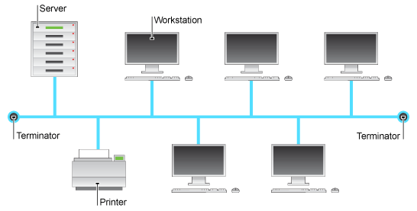
Bus Network Topology
Computer Fundamentals: Pradeep K. Sinha & Priti Sinha
A bus network is a network topology in which nodes are directly connected to a common linear (or branched) half-duplex link called a bus.
Ref. Page 341

Slide 7
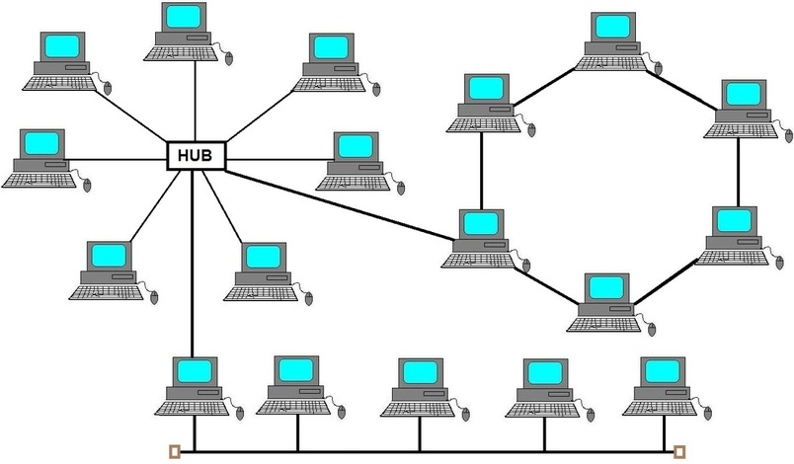
Hybrid Network Topology
Computer Fundamentals: Pradeep K. Sinha & Priti Sinha
Hybrid network topology is a combination of two or more different basic network topologies. For example, it can be star-ring, star-bus topologies, etc.
Ref. Page 341

Slide 8
Network Types
Computer Fundamentals: Pradeep K. Sinha & Priti Sinha
Networks are broadly classified into two types: Local Area Network (LAN) and Wide Area Network (WAN)
A local area network (LAN) is a network that connects computers and other devices in a relatively small area, typically a single building or a group of buildings.
A wide area network (WAN) is a telecommunications network or computer network that extends over a large geographical distance.
A personal area network (PAN) is a technology that could enable wearable smart devices to communicate with other nearby devices.
Metropolitan Area Network (MAN) covered area larger then LAN and less then WAN
Ref. Page 342

Slide 9
Network Interface Card (NIC)
Computer Fundamentals: Pradeep K. Sinha & Priti Sinha
Hardware device that allows a computer to be connected to a network, both functionally and physically
Printed circuit board installed on to one of the expansion slots of computer
Provides a port on the back to which network cable is attached
Ref. Page 344

Slide 10
The OSI Model
Computer Fundamentals: Pradeep K. Sinha & Priti Sinha
The Open System Interconnection (OSI) model is framework for defining standards for linking heterogeneous computers in a packet switched network
Standardized OSI protocol makes it possible for any two heterogeneous computer systems, located anywhere in the world, to easily communicate with each other
Separate set of protocols is defined for each layer in its seven-layer architecture. Each layer has an independent function
Ref. Page 344

Slide 11
Layers, Interfaces, and Protocols in the OSI Model
Computer Fundamentals: Pradeep K. Sinha & Priti Sinha
Node 1 Node 2
Process A
Process B
Layer 7 (application)
Application protocol
Layer 7 (application)
Interface
Interface
Layer 6
Presentation protocol
Layer 6 (presentation)
(presentation)
Interface
Interface
Layer 5 (session)
Session protocol
Layer 5 (session)
Interface
Interface
Layer 4 (transport)
Transport protocol
Layer 4
(transport)
Interface
Network protocol
Interface
Layer 3 (network)
Layer 3 (network)
Interface
Interface
Layer 2 (data link)
Data-link protocol
Layer 2
(data link)
Interface
Interface
Layer 1 (physical)
Physical protocol
Layer 1 (physical)
Network
Ref. Page 346

Slide 12
Computer Fundamentals: Pradeep K. Sinha & Priti Sinha
An example illustrating transfer of message M from sending node to the receiving node in the OSI model: H_{n}, header added by layer n:T_{n}, trailer added by layer n.
Sending node
Receiving node
Process A
Process B
H₇
M
H₇
M
H₆ | H | M
H₆ | H₇ | M
7
H₅ | H₆ | H₇ | M
H₅ | H₆ | H₇ | M
H₄ | H₅ | H₆ | H₇ | M₁
H₄ | H₅ | H₆ | H₇ | M₂
H₄ | H₅ | H₆ | H₇ | M₁
H₄ | H₅ | H₆ | H₇ | M₂
H₃ | H₄ | H₅ | H₆ | H₇ | M₁
H₃ | H₄ | H₅ | H₆ | H₇ | M₂
H₃ | H₄ | H₅ | H₆ | H₇ | M₁
H₃ | H₄ | H₅ | H₆ | H₇ | M₂
H₂ | H₃ | H₄ | H₅ | H₆ | H₇ | M₁ | T₂
H₂ | H₃ | H₄ | H₅ | H₆ | H₇ | M | T₂
H₂ | H₃ | H₄ | H₅ | H₆ | H₇ | M | 1 ^{T}2
H₂ | H₃ | H₄ | H₅ | H₆ | H₇ | M | T₂
2
2
Ref. Page 348

Slide 13
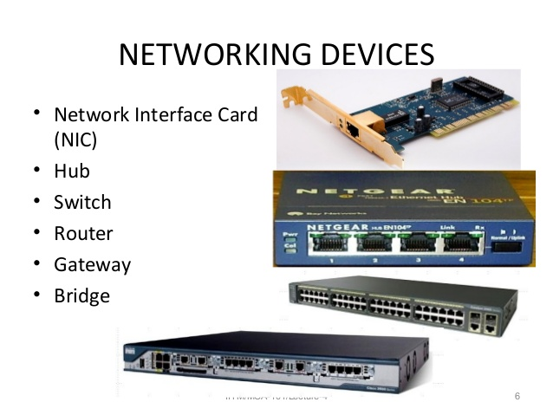
Network Devices Name

Slide 14
Network Devices Definition
Computer Fundamentals: Pradeep K. Sinha & Priti Sinha
Hub is a networking device which is used to connect multiple network hosts. A network hub is also used to do data transfer.
Switch also works at the layer of LAN (Local Area Network) but you can say that a switch is more intelligent than a hub. While hub just does the work of data forwarding, a switch does ‘filter and forwarding.
Router is a network device which is responsible for routing traffic from one to another network.
Repeater is an electronic device that amplifies the signal it receives.
Ref. Page 349

Slide 15
Wireless Technologies
Computer Fundamentals: Pradeep K. Sinha & Priti Sinha
2G and 3G
Wireless LAN
WiMAX
Wireless Local Loop (WLL)
Radio-router
Multihop Wireless Network
Wireless Application Protocol (WAP)
Ref. Page 351

